Slide 1
USMC Robotics Club 2017
3RD class of Arduino Module

Slide 2
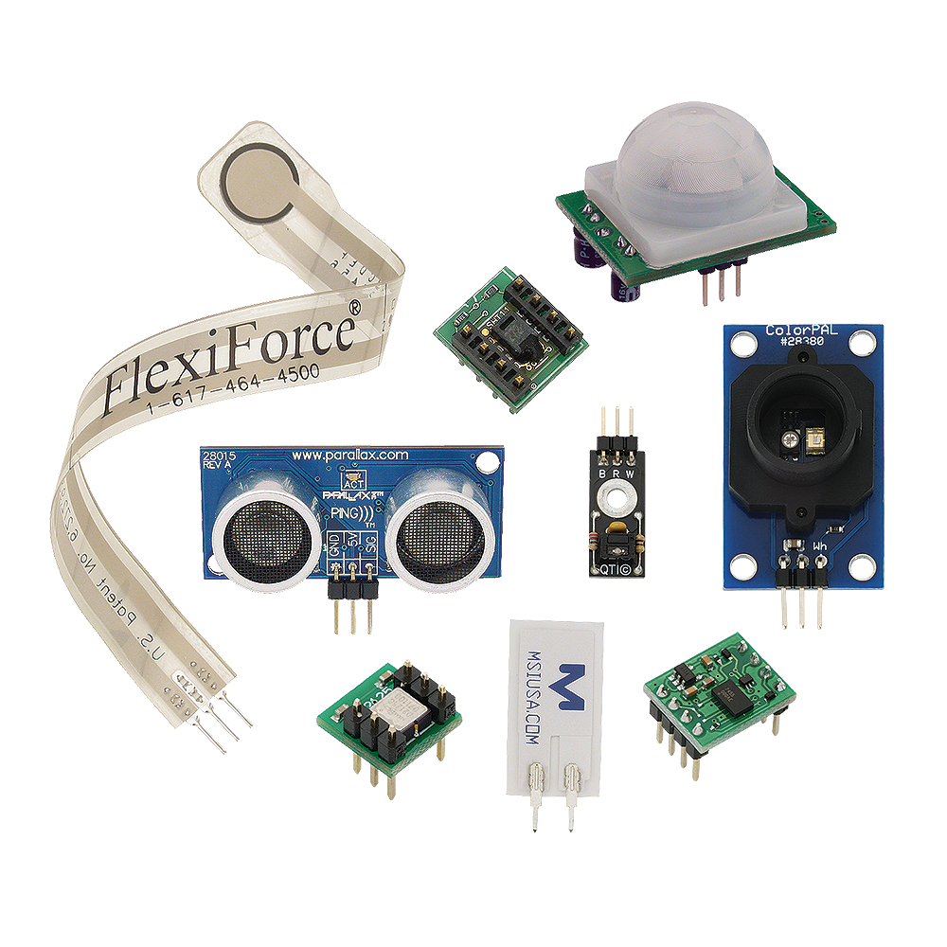
Sensors
Sensors are hardware electronics that are able to measure parameters in controlled environments.
They are dependent on microprocessors or microcontrollers, as they only retrieve information from surroundings, not processing them.
Examples of sensors are IC 555 (timer) , ultrasonic, infrared and camera.

Slide 3
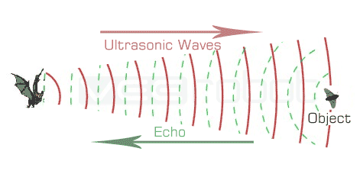
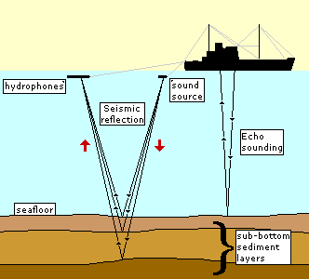
Ultrasonic sensors
Ultrasonic sensors are inspired by animals that uses echo location (dolphins and bats), They use sound to locate objects and far away where their eyes cannot see.
Submarines or oil rigs use echolocation to detect certain objects. (different materials reflect sound waves with different depth.)
Note that sound waves travel faster in water than in air.

Slide 4
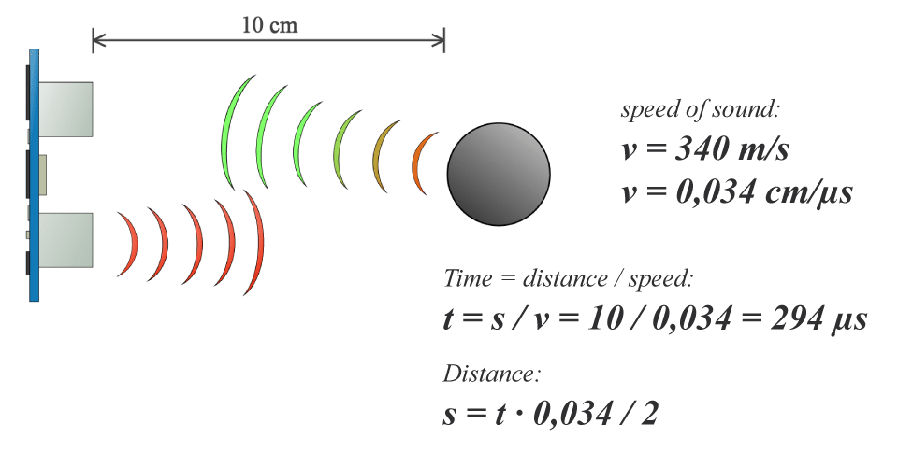
But how does it work?

Slide 5
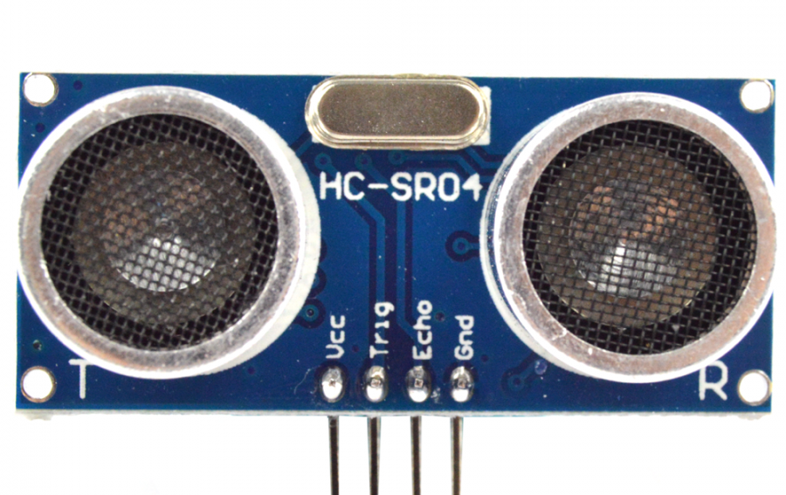
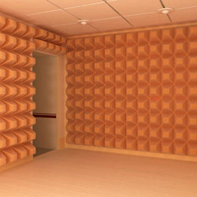


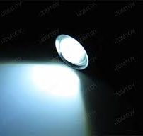
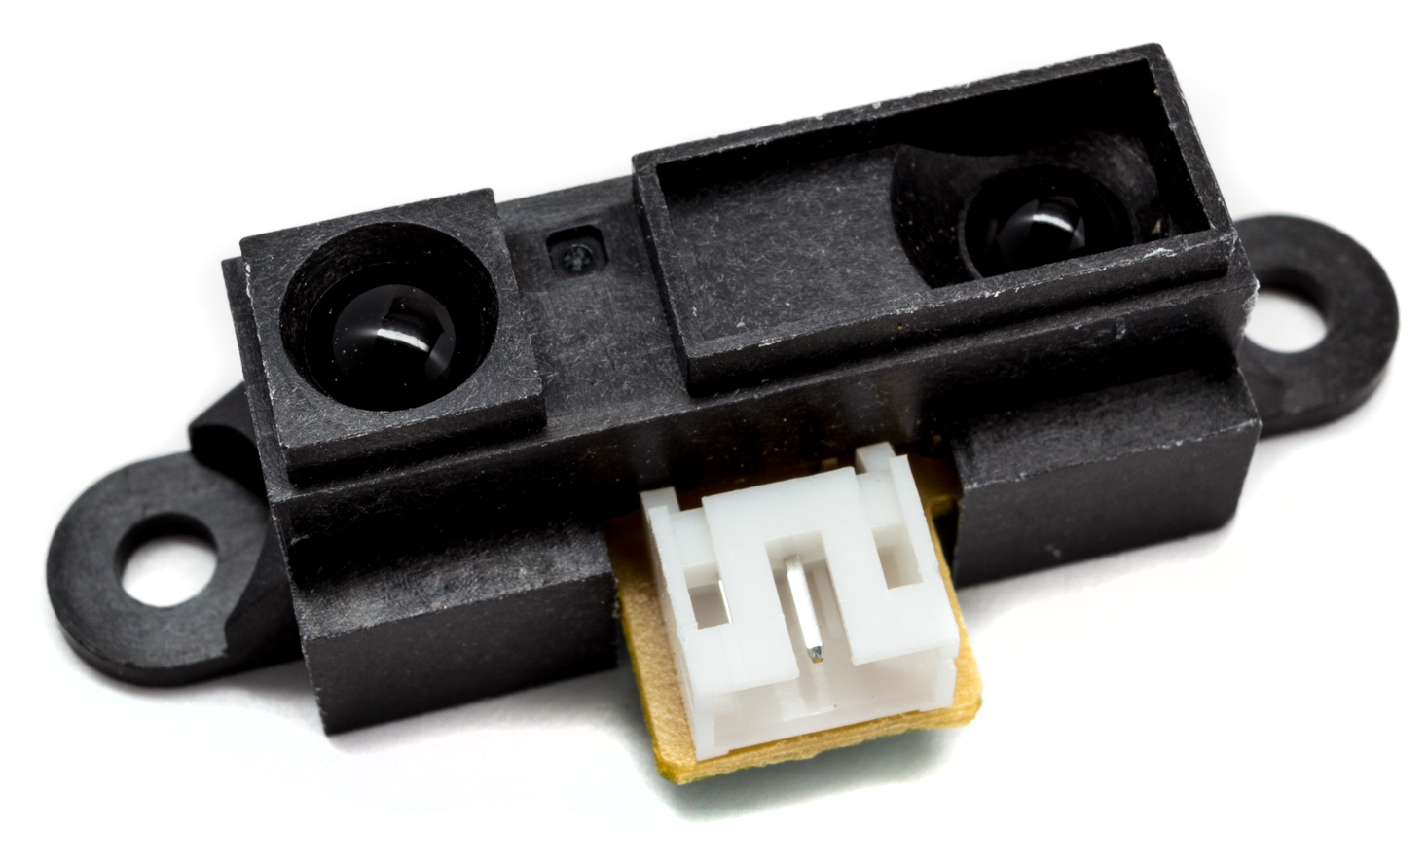
Ultrasonic vs infrared
Despite both being used as sensors for measuring distances, their application fields are different.
Ultrasonic sensors uses sound to measure while infrared uses light.
This makes ultrasonic sensors more weaker to sound absorbing objects(uneven surface) and infrared sensors more weaker to bright environments.

Slide 6
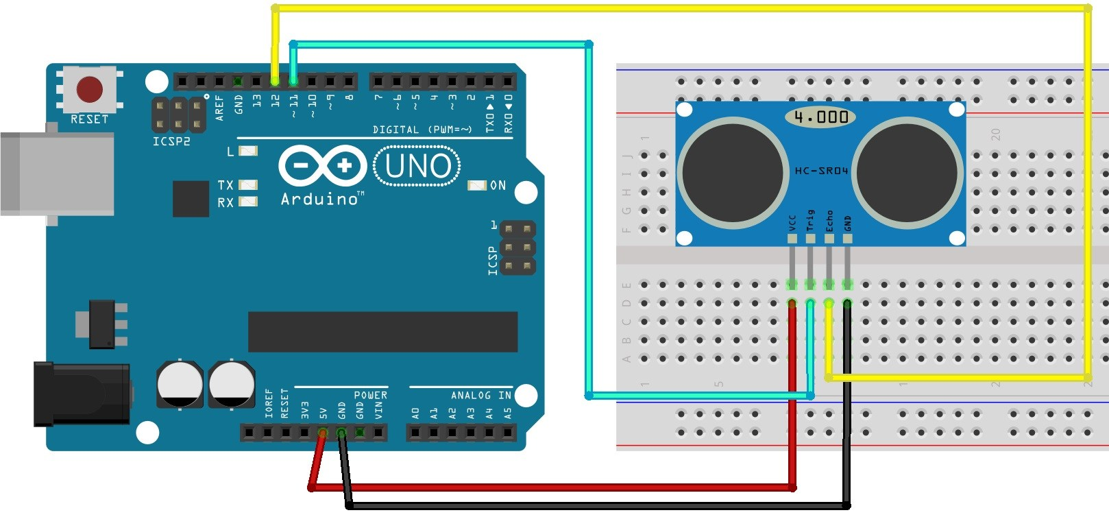
Hc-sr04 Ultrasonic sensor
In this course, we will be learning how to use a ultrasonic sensor to control DC motors to built a simple maze robot.(with u controlling it)
We will start programming after the presentation since the robot chassis is already built for you.

Slide 7

Beginning…
Now let us start! In your groups, you are provided with an Arduino UNO R3 module + DK electronics motor driver + Robot Chasis to work on.
Further instructions will be provided.
Please handle them carefully and responsibly.

